Slide 1

Chapter 4
Algebra: Equations and Inequalities

Slide 2
4.6
Linear Inequalities in One Variable

Slide 3
Targets
I can graph subsets of real numbers on a number line.
I can solve linear inequalities.
I can identify linear inequalities with no solution or all real numbers as solutions.
I can solve applied problems using linear inequalities.
Notes:
3

Slide 4
Linear Inequalities
A linear inequality :
ax + b ≤ c
where the inequality symbol can be <, >, ≤, or ≥.
Solving an inequality is the process of finding the set of numbers that make an inequality a true statement.
A solution set is the set of all numbers that satisfy the inequality.
Notes:
4

Slide 5
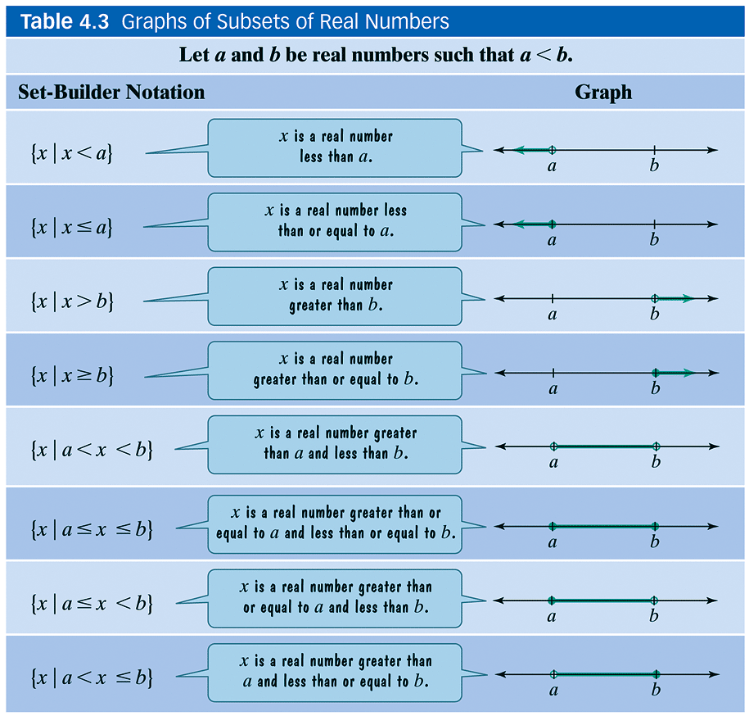
Graphing Subsets of Real Numbers on a Number Line
Notes:
5

Slide 6
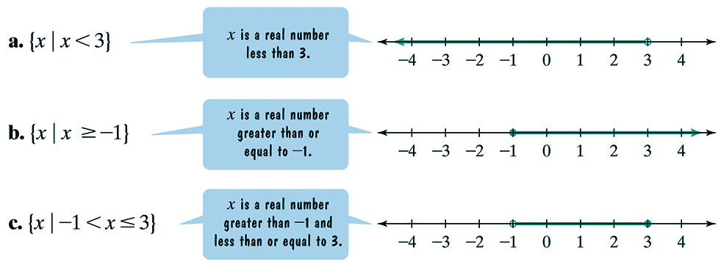
Example 1: Graphing Subsets of Real Numbers
Such That
Notes:
6

Slide 7
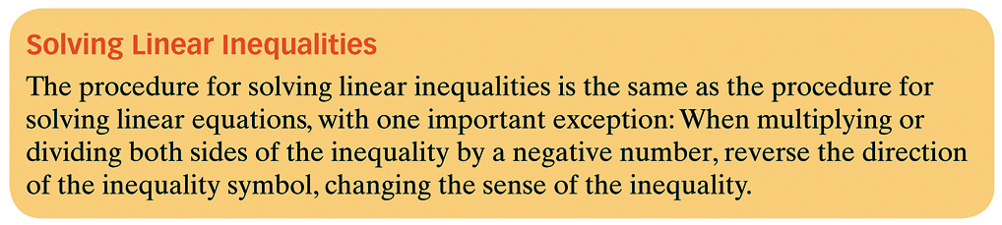
Solving Linear Inequalities in One Variable
Notes:
7

Slide 8



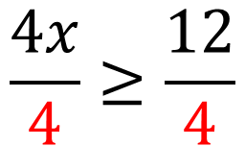

Example 2: Solving a Linear Inequality
Solve:
$$4x−7≥5$$
$$4x−7+7≥5+7$$
$$4x≥12$$
$$\frac{4x}{4}≥\frac{12}{4}$$
$$x≥3$$
Notes:
8

Slide 9
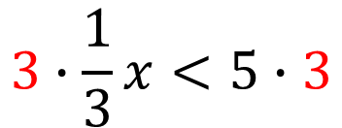
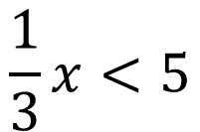

Example 3: Solving Linear Inequalities
Solve:
$$\frac{1}{3}x<5$$
$$3∙\frac{1}{3}x<5∙3$$
$$x<15$$
Notes:
9

Slide 10






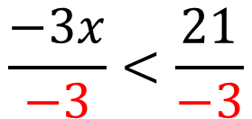



Example 3: Solving Linear Inequalities
Solve:
$$−3x<21$$
$$−3x<21$$
$$−3x+3x<21+3x$$
$$\frac{−3x}{−3}<\frac{21}{−3}$$
$$0<21+3x$$
$$x>7$$
$$0−21<21−21+3x$$
Whenever you multiply or divide by a negative number, you must flip the inequality
$$−21<3x$$
$$−7<x$$
$$x>7$$
Notes:
10

Slide 11





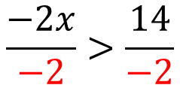


Example 4: Solving a Linear Inequality
Solve:
$$6x−12>8x+2$$
$$6x−12>8x+2$$
$$6x−12+12>8x+2+12$$
$$6x>8x+14$$
$$6x−8x>8x−8x+14$$
$$−2x>14$$
Whenever you multiply or divide by a negative number, you must flip the inequality
$$\frac{−2x}{−2}>\frac{14}{−2}$$
$$x<−7$$
Notes:
11

Slide 12
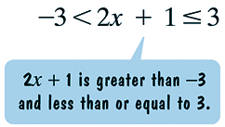
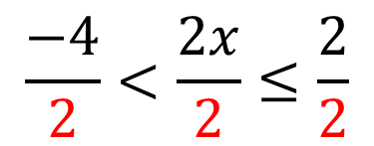



Example 6: Solving a Three-Part Inequality
Solve:
$$−3<2x+1≤3$$
$$−3−1<2x+1−1≤3−1$$
$$−4<2x≤2$$
$$\frac{−4}{2}<\frac{2x}{2}≤\frac{2}{2}$$
$$−2<x≤1$$
Notes:
12

Slide 13




Example 7: Solving a Linear Inequality
Solve:
$$3x+3>3x+5$$
$$3x−3x+3>3x−3x+5$$
$$3>5$$
FALSE!!!
No solution or the solution is the empty set
$$∅$$
Notes:
13

Slide 14


Example 8: Solving a Linear Inequality
Solve:
$$2x+10≤2x+14$$
$$2x−2x+10≤2x−2x+14$$
$$10≤14$$
TRUE!!!
The solution is all real numbers
Notes:
14

Slide 15
Assignment
MyMathLab: Solving Inequalities

