Slide 1

Chapter 4
Algebra: Equations and Inequalities

Slide 2
4.5
Modeling Using Variation

Slide 3
Targets
I can solve direct variation problems.
I can solve inverse variation problems.
I can solve combined variation problems.
Notes:
3

Slide 4
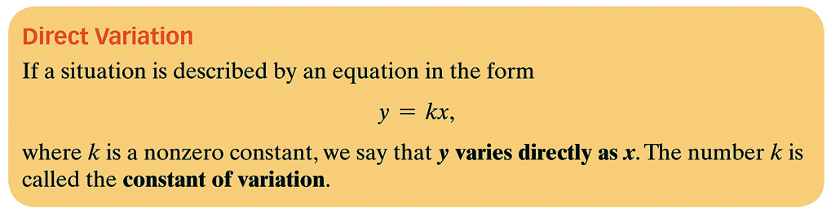

Slide 5


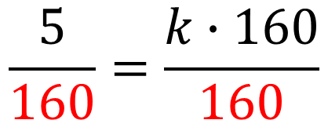
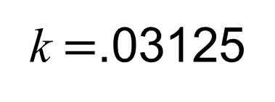

Example 1: Solving a Direct Variation Problem
The volume of blood, V, in a person’s body varies directly as body weight, W. A person who weighs 160 pounds has approximately 5 quarts of blood. Estimate the number of quarts of blood in a person who weighs 200 pounds.
Write the variation equation using
variables that make sense
Plug in the numbers from the problem
and solve for k
Re-write the variation using the
number for k
Notes:
5

Slide 6


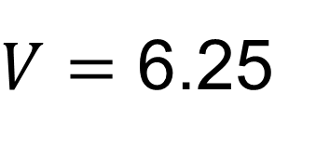
Example 1: continued
Use the equation to answer the
question from the problem
A person who weighs 200 pounds has approximately 6.25 quarts of blood.
Notes:
6

Slide 7
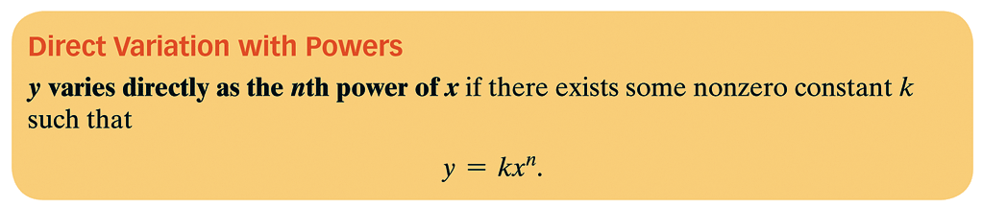

Slide 8



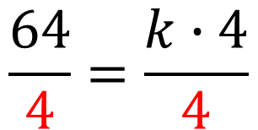

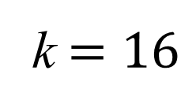
Example 2: Solving a Direct Variation Problem
The distance, s, that a body falls from rest varies directly as the square of the time, t, of the fall. If skydivers fall 64 feet in 2 seconds, how far will they fall in 4.5 seconds?
Write the variation equation using
variables that make sense
Plug in the numbers from the problem
and solve for k
Re-write the variation using the
number for k
Notes:
8

Slide 9




Example 1: continued
Use the equation to answer the
question from the problem
A skydiver that falls for 4.5.seconds travels 324 ft.
Notes:
9

Slide 10
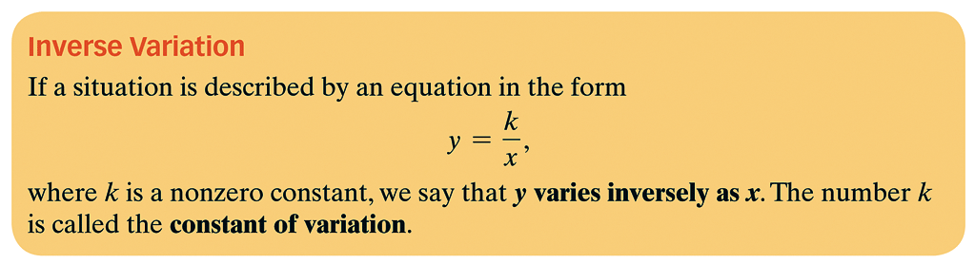

Slide 11
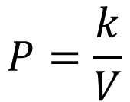
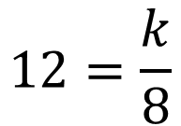
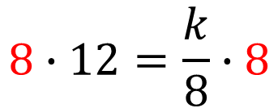
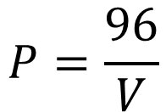

Example 3: Solving an Inverse Variation Problem
If the temperature is constant, the pressure, P, of a gas in a container varies inversely as the volume, V, of the container. The pressure of a gas sample in a container whose volume is 8 cubic inches is 12 pounds per square inch. If the sample expands to a volume of 22 cubic inches, what is the new pressure of the gas?
Write the variation equation using
variables that make sense
Plug in the numbers from the problem
and solve for k
Re-write the variation using the
number for k
Notes:
11

Slide 12
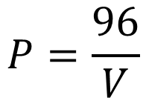
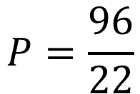

Example 1: continued
Use the equation to answer the
question from the problem
When the volume increases to 22 cubic inches, the pressure decreases to 4.3636 pounds per square inch.
Notes:
12

Slide 13
Combined Variation
In combined variation, direct and inverse variation occur at the same time.

Slide 14
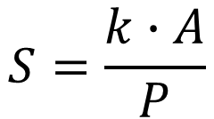
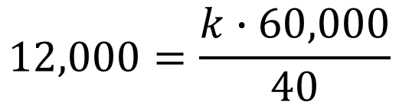

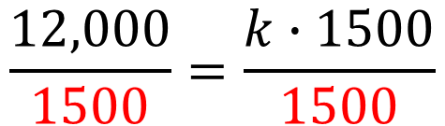
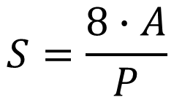

Example 4: Solving a Combined Variation Problem
The owners of Rollerblades Plus determine that the monthly sales, S, of its skates vary directly as its advertising budget, A, and inversely as the price of the skates, P. When $60,000 is spent on advertising and the price of the skates is $40, the monthly sales are 12,000 pairs of rollerblades. Determine monthly sales if the amount of the advertising budget is increased to $70,000.
Write the variation equation using
variables that make sense
Plug in the numbers from the problem
and solve for k
Re-write the variation using the
number for k
Notes:
14

Slide 15
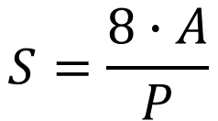
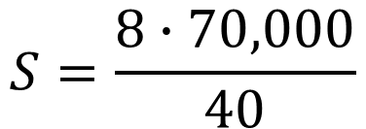

Example 4: continued
With a $70,000 advertising budget and $40 price, the company can expect to sell 14,000 pairs of rollerblades in a month.
Notes:
15

Slide 16
Assignment
MyMathLab: Variation Problems

