Slide 1

Chapter 9
Measurement

Slide 2
9.1
Measuring Length; The Metric System

Slide 3
Objectives
Use dimensional analysis to change units of measurement.
Understand and use metric prefixes.
Convert units within the metric system.
Use dimensional analysis to change to and from the metric system.
Notes:
3

Slide 4
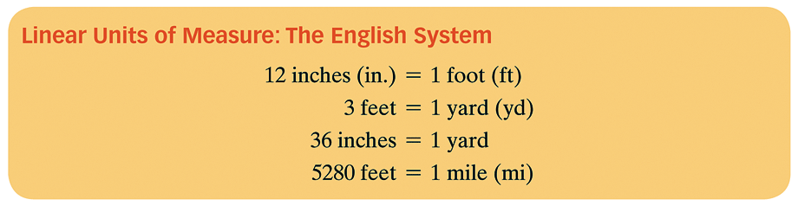
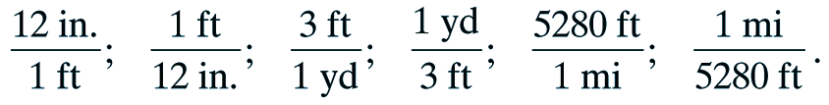
Length
Unit Fractions contain different units and the value of the unit is 1. Here are some examples of unit fractions:

Slide 5
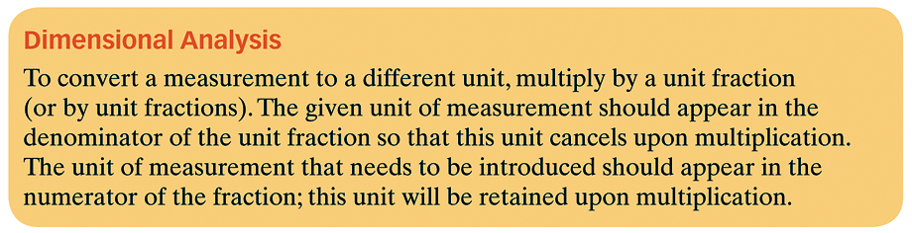

Slide 6
Example 1: Using Dimensional Analysis to Change Units of Measurement.
Convert:
40 inches to feet
b. 13,200 feet to miles

Slide 7
Example 1: Using Dimensional Analysis to Change Units of Measurement.
Convert:
c. 9 inches to yards

Slide 8
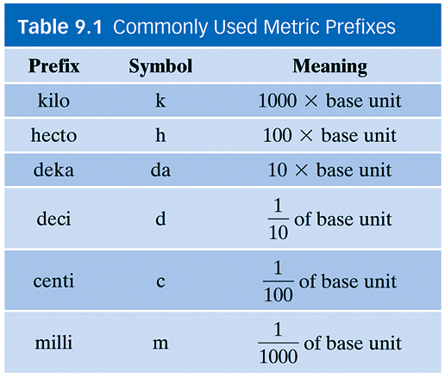
Length and the Metric System
Used in most industrialized countries
Based on powers of ten.
Base Unit

Slide 9
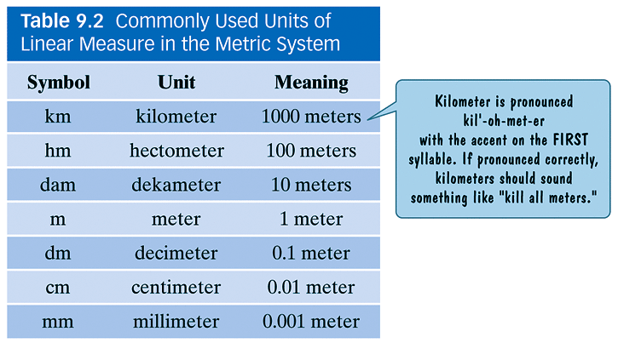
Commonly Used Units of Linear Measure in the Metric System
The basic unit for linear measure in the metric system is the meter.

Slide 10
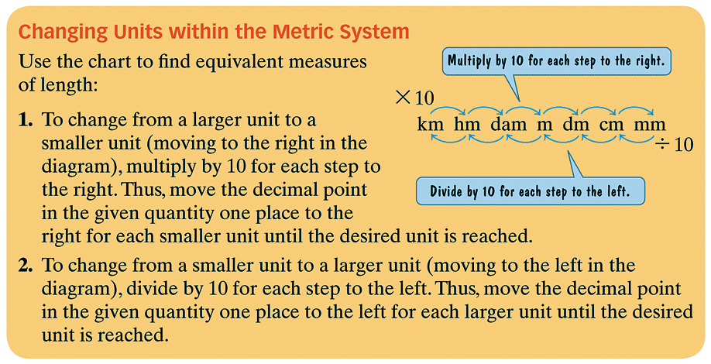

Slide 11
Mnemonic Device to Help Us Remember
Kilo
Hecto
Deka
Base
Deci
Centi
Milli
King
Henry
Died
By
Drinking
Chocolate
Milk

Slide 12


Example 2a: Changing Units Within the Metric System
Convert 504.7 meters to kilometers.
To convert from meters to kilometers, start at meters and move three steps to the left to obtain kilometers:
Hence we move the decimal point 3 places to the left.

Slide 13


Example 2b continued
Convert 27 meters to centimeters
To convert from meters to centimeters, start at meters and move two steps to the right to obtain centimeters:
Hence we move the decimal point 2 places to the right.

Slide 14


Example 2c continued
Convert 704 mm to hm
To convert from mm (millimeters) to hm (hectometers), start at mm and move five steps to the left to obtain hm:
Hence, we move the decimal point 5 places to the left.

Slide 15


Example 2d continued
Convert 9.71 dam to dm
To convert from dam (dekameters) to dm (decimeters), start at dam and move two steps to the right to obtain dm:
Hence, we move the decimal point 2 places to the right.

Slide 16
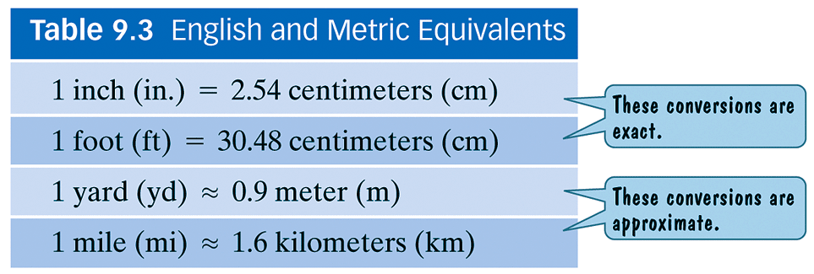
Using Dimensional Analysis to Change
To and From the Metric System
Approximate English and Metric Equivalents

Slide 17
Example 3a: Using Dimensional Analysis to Change to and from the Metric System
Convert 8 inches to centimeters
Use the unit fraction: 2.54 cm
1 in
8 inches = 8 in ∙ 2.54 cm =8(2.54) cm = 20.32 cm
1 1 in

Slide 18
Example 3b: Using Dimensional Analysis to Change to and from the Metric System
Convert 125 miles to kilometers
Use the unit fraction: 1.6 km
1 mi
125 miles = 125 mi ∙ 1.6 km =125(1.6) km = 200 km
1 1 mi

Slide 19
Example 3c continued
Convert 26,800 millimeters to inches.
From the table we see that
26,800 mm = 2680.0 cm
Use the unit fraction:
26,800 mm = 2680 cm

Slide 20
Assignment
MyMathLab – 9.1 Measuring Length

