Slide 1

Chapter 7
Personal Finance: Taxes and Interest

Slide 2
7.4
Compound Interest

Slide 3
7.4
Compound Interest

Slide 4
Targets
I can use the compound interest formulas.
I can calculate present value.
I understand and compute effective annual yield.
Notes:
4

Slide 5
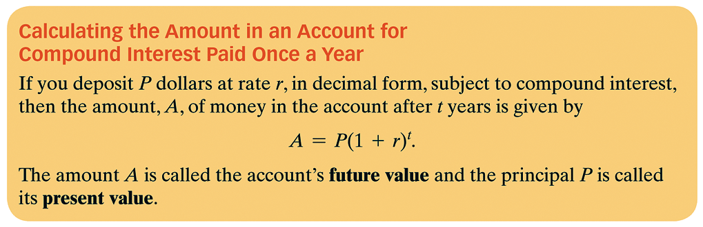
Compound Interest
Compound interest is interest computed on the original principal as well as on any accumulated interest.
Notes:
5

Slide 6




Example 1: Compound Interest
You deposit $2000 in a savings account at Hometown Bank, which has a rate of 6%.
Find the amount, A, of money in the account after 3 years subject to compound interest.
b. Find the interest.
$$A=P{\left(1+r\right)}^{t}$$
$$A=2000{\left(1+.06\right)}^{3}$$
$$A=2000{\left(1.06\right)}^{3}$$
$$A=\$2382.03$$
$$I=2382.03−2000=\$382.03$$

Slide 7
Example 1: Compound Interest continued
The amount in the account after 3 years is $2382.03. So, we take the difference of this amount and the principal to obtain the interest amount.
$2382.03 – $2000 = $382.03
Thus, the interest you make after 3 years is $382.03.

Slide 8
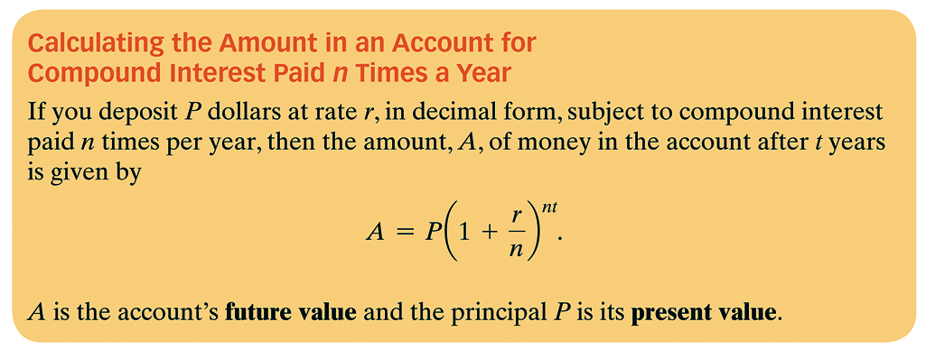
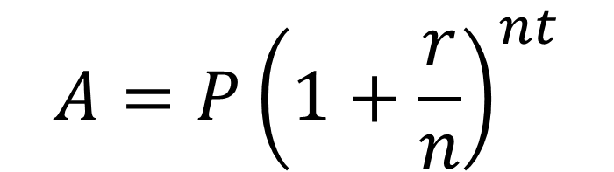
Compound Interest
$$A=P{\left(1+\frac{r}{n}\right)}^{nt}$$
Notes:
8

Slide 9


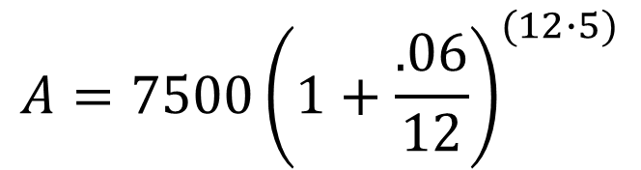
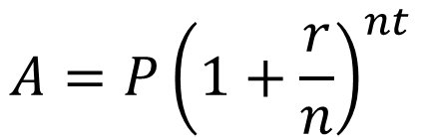
Example 2: Using the Compound Interest Formula
You deposit $7500 in a savings account that has a rate of 6%. The interest is compounded monthly.
How much money will you have after five years?
b. Find the interest after five years.
$$A=P{\left(1+\frac{r}{n}\right)}^{nt}$$
$$A=7500{\left(1.005\right)}^{(60)}$$
$$A=7500{\left(1+\frac{.06}{12}\right)}^{(12∙5)}$$
$$A=\$10,116.38$$
$$I=10,116.38−7500=\$2616.38$$

Slide 10
Example 2: Using the Compound Interest Formula
Rounded to the nearest cent, you will have $10,116.38 after five years.
b. The amount in the account after 5 years is $10,116.38. So, we take the difference of this amount and the principal to obtain the interest amount.
$ 10,116.38 – $7500 = $2616.38
Thus, the interest you make after 5 years is $2616.38.

Slide 11
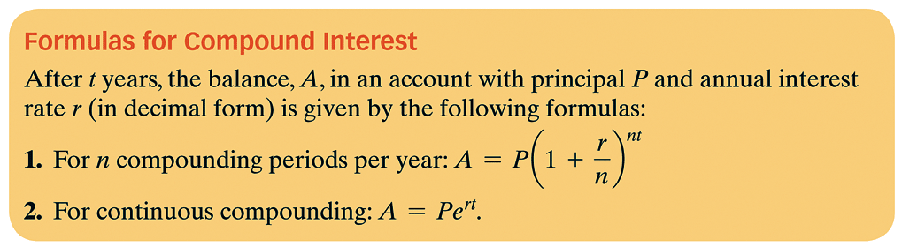
Compound Interest
Continuous Compounding
Some banks use continuous compounding, where the compounding periods increase infinitely.

Slide 12

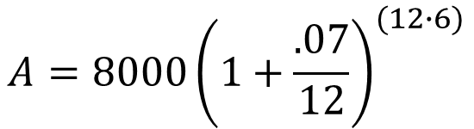

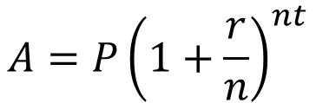



Example 3: Choosing Between Investments
You decide to invest $8000 for 6 years and you have a choice between two accounts. The first pays 7% per year, compounded monthly. The second pays 6.85% per year, compounded continuously. Which is the better investment?
Monthly Continuously
$$A=P{\left(1+\frac{r}{n}\right)}^{nt}$$
$$A=Pe^{rt}$$
$$A=8000{\left(1+\frac{.07}{12}\right)}^{(12∙6)}$$
$$A=8000e^{(.0685∙6)}$$
$$A=\$12,066.60$$
$$A=8000{\left(1.005833\right)}^{(72)}$$
The one that pays monthly is the better investment
$$A=\$12,160.84$$

Slide 13
Example 3: Choosing Between Investments continued
6.85% account:
A = Pe^{rt} = 8000e^{0.0685(6)} ≈ 12,066.60
The balance in this account after 6 years is $12,066.60.
The better investment is the 7% monthly compounding option.

Slide 14
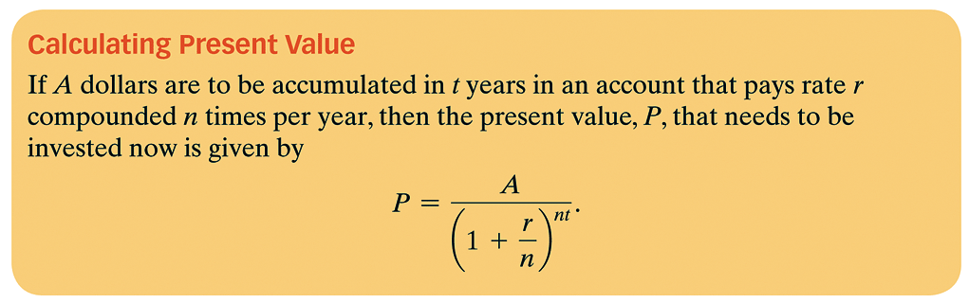
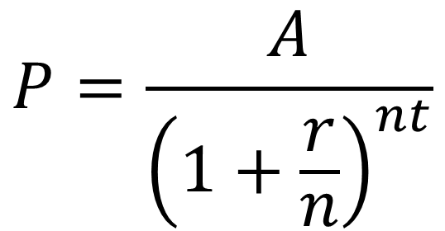
Planning for the Future with Compound Interest
$$P=\frac{A}{{\left(1+\frac{r}{n}\right)}^{nt}}$$
Notes:
14

Slide 15
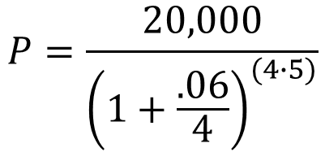
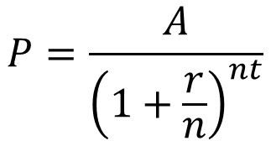

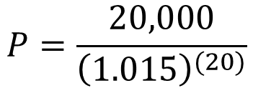
Example 4: Calculating Present Value
How much money should be deposited in an account today that earns 6% compounded quarterly so that it will accumulate to $20,000 in five years?
$$P=\frac{20,000}{{\left(1.015\right)}^{(20)}}$$
$$P=\frac{A}{{\left(1+\frac{r}{n}\right)}^{nt}}$$
$$P=\$14,849.41$$
$$P=\frac{20,000}{{\left(1+\frac{.06}{4}\right)}^{(4∙5)}}$$

Slide 16

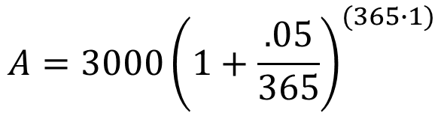
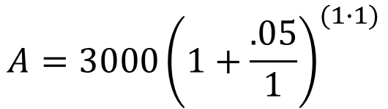
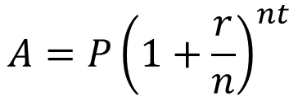
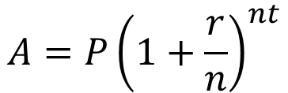



If you deposit $3,000 into an account that pays a 5% interest rate, how much more money is in the account after one year if the interest compounded daily rather than compounded once per year?
Daily Once
$$A=P{\left(1+\frac{r}{n}\right)}^{nt}$$
$$A=P{\left(1+\frac{r}{n}\right)}^{nt}$$
$$A=3000{\left(1+\frac{.05}{365}\right)}^{(365∙1)}$$
$$A=3000{\left(1+\frac{.05}{1}\right)}^{(1∙1)}$$
$$A=3000{\left(1.000136986\right)}^{(365)}$$
$$A=3000{\left(1.05\right)}^{(1)}$$
$$A=\$3153.80$$
$$A=\$3150$$
$$\$3153.80−3150=\$3.80$$

Slide 17
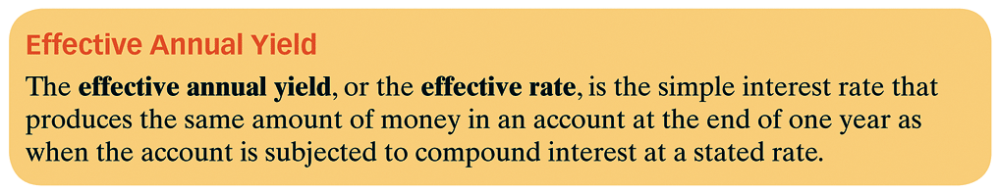
Effective Annual Yield

Slide 18


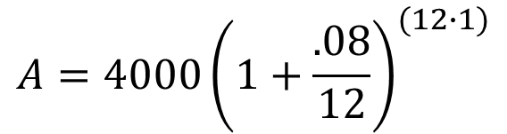


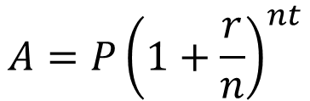







Example 5: Understanding Effective Annual Yield
You deposit $4000 in an account that pays 8% interest compounded monthly.
Find the future value after one year.
b. Use the future value formula for simple interest to determine
the effective annual yield.
$$A=4000{\left(1.0066667\right)}^{(12)}$$
$$A=P{\left(1+\frac{r}{n}\right)}^{nt}$$
$$A=\$4332$$
$$A=4000{\left(1+\frac{.08}{12}\right)}^{(12∙1)}$$
$$4332=4000+4000r$$
$$A=P(1+rt)$$
$$332=4000r$$
$$4332=4000(1+r∙1)$$
$$4000$$
$$4000$$
$$4332=4000(1+r)$$
$$r=.083$$
$$r=8.3\%$$

Slide 19
Assignment
MyMathLab: 7.4 Compound Interest

