Slide 1

Chapter 7
Personal Finance: Taxes and Interest

Slide 2
7.2
Income Tax

Slide 3
Targets
I can determine gross income, adjustable gross income, and taxable income.
I can calculate federal income tax.
I can calculate FICA taxes.
I can solve problems involving working teens and taxes.
Notes:
3

Slide 4
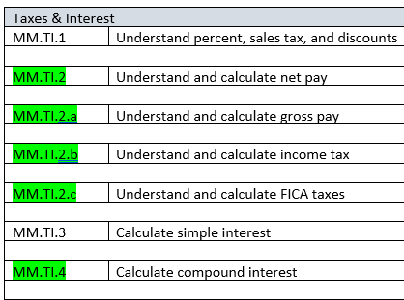

Slide 5
Percent and Income Tax
Calculating Income Tax:
Determine your adjusted gross income:
2. Determine your taxable income:
Notes:
5

Slide 6
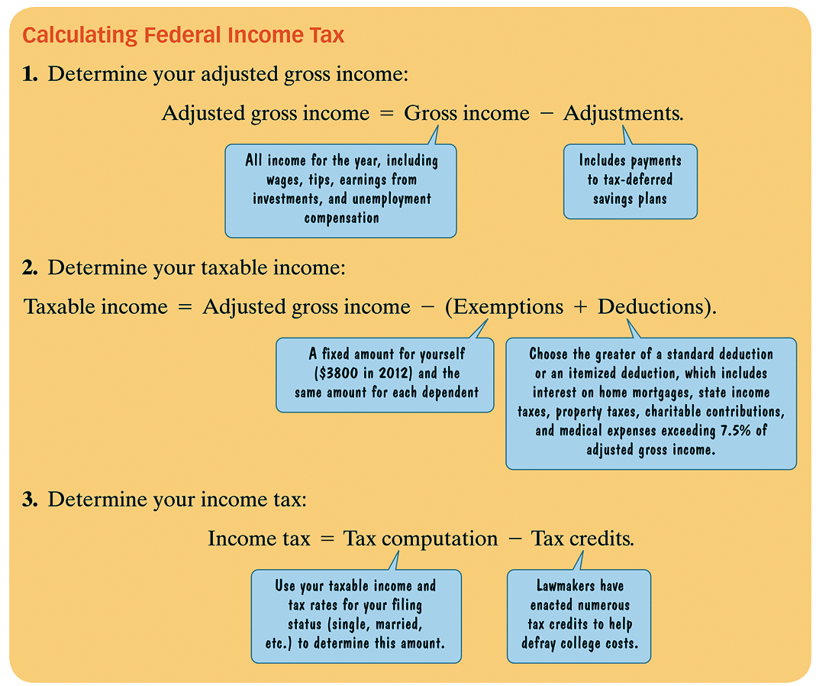

Slide 7
Example 1: Gross Incomes, Adjusted Gross Income, and Taxable Income
A single man earned wages of $46,500, received $1850 in interest from a savings account, received $15,000 in winnings on a television game show, and contributed $2300 to a tax-deferred savings plan. He is entitled to a personal exemption of $3800 and a standard deduction of $5950. The interest on his home mortgage was $6500, he paid $2100 in property taxes and $1855 in state taxes, and he contributed $3000 to charity.
a. Determine the man’s gross income.
b. Determine the man’s adjusted gross income.
c. Determine the man’s taxable income.
Notes:
7

Slide 8
Example 1: Gross Incomes, Adjusted Gross Income, and Taxable Income continued
A single man earned wages of $46,500, received $1850 in interest from a savings account, received $15,000 in winnings on a television game show, and contributed $2300 to a tax-deferred savings plan. He is entitled to a personal exemption of $3800 and a standard deduction of $5950. The interest on his home mortgage was $6500, he paid $2100 in property taxes and $1855 in state taxes, and he contributed $3000 to charity.
a. Determine the man’s gross income.
Gross Income = $46,500 + $1850 + $15,000 = $63,350
b. Determine the man’s adjusted gross income.
Adjusted Gross Income = $63,350 − $2300 = $61,050
c. Determine the man’s taxable income.
Deductions = $6500 + $2100 +$1855 +$3000 = $13,455
Notes:
8

Slide 9
Example 1: Gross Incomes, Adjusted Gross Income, and Taxable Income continued
A single man earned wages of $46,500, received $1850 in interest from a savings account, received $15,000 in winnings on a television game show, and contributed $2300 to a tax-deferred savings plan. He is entitled to a personal exemption of $3800 and a standard deduction of $5950. The interest on his home mortgage was $6500, he paid $2100 in property taxes and $1855 in state taxes, and he contributed $3000 to charity.
c. Determine the man’s taxable income.
Taxable Income = Adjusted Gross income – (Exemptions + Deductions)
= $61,050 – ($3800 + $13,455)
= $61,050 – $17,255
= $43,795
Notes:
9

Slide 10
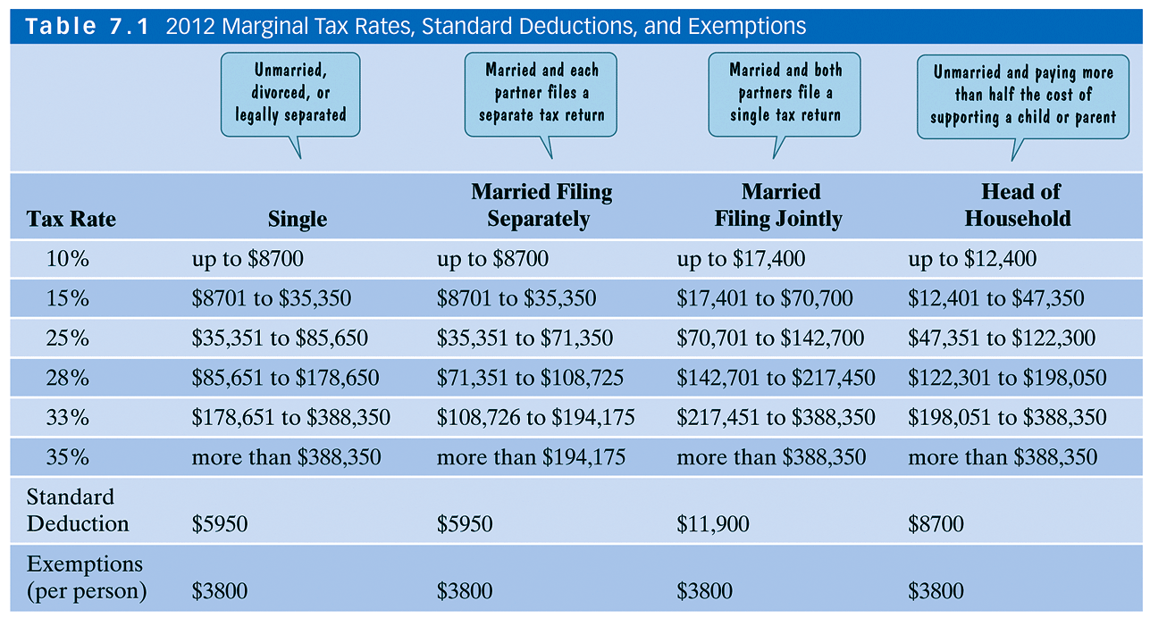
Percent and Income Tax
The table shows tax rates, standard deductions, and exemptions for the four filing status categories.
Notes:
10

Slide 11
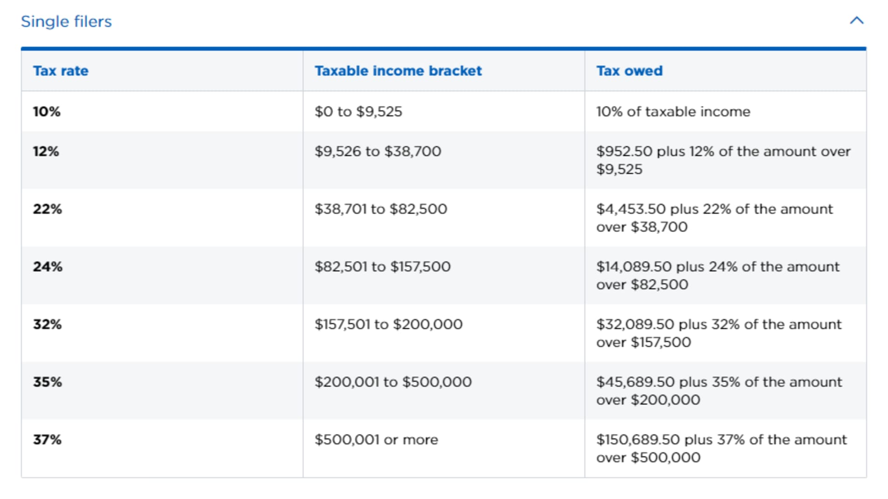

Slide 12
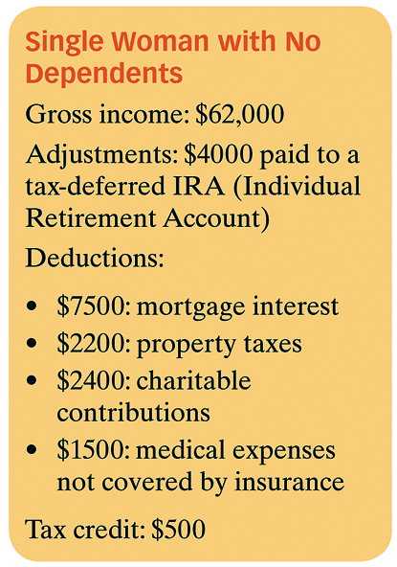
Example 2: Computing Federal Income Tax
Calculate the federal income tax owed by a single woman with no dependents whose gross income, adjustments, deductions, and credits are given. Use the marginal tax rates from the table.
Notes:
12

Slide 13
Example 2: Computing Federal Income Tax continued
Step 1. Determine the adjusted gross income.
Adjusted gross income = Gross income – Adjustments
= $62,000 − $4000
= $58,000
Notes:
13

Slide 14
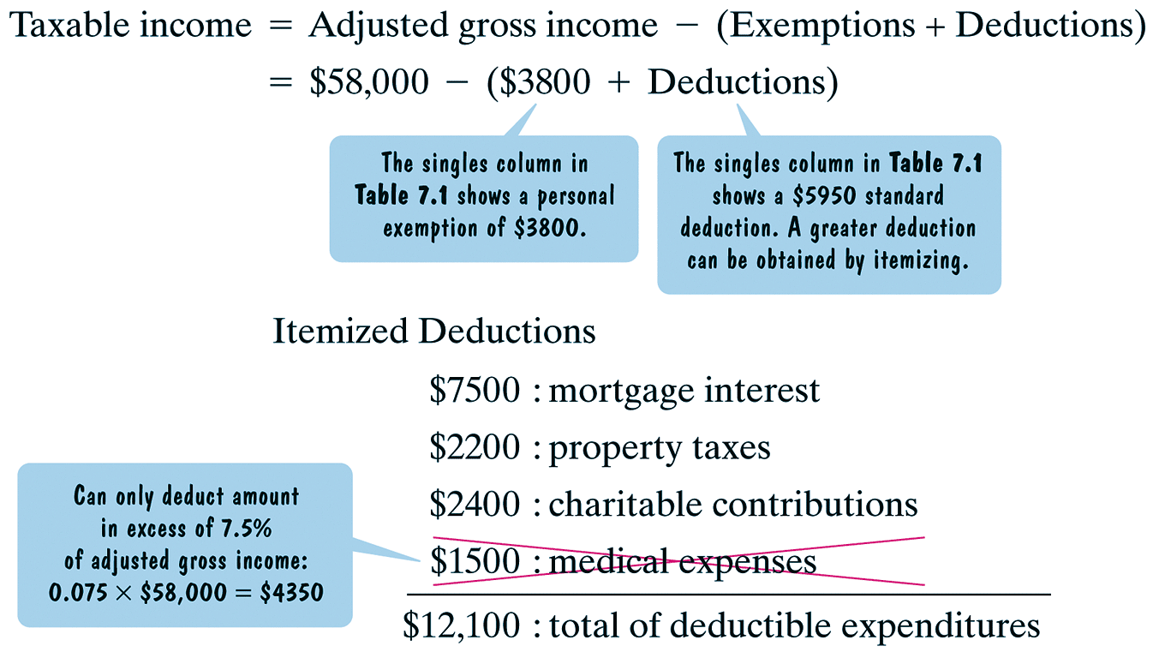
Example 2: Computing Federal Income Tax continued
Step 2. Determine taxable income.
We substitute $12,100 for deductions in the formula for taxable income.
Notes:
14

Slide 15
Example 2: Computing Federal Income Tax continued
Taxable income = Adjusted gross income – (Exemptions + Deductions)
= $58,000 – ($3800 + $12,100)
= $58,000 – $15,900
= $42,100
Step 3. Determine the income tax.
Income tax = Tax computation – Tax credits
= Tax Computation − $500
Since the single woman taxable income is $42,100 she falls in the tax bracket of 25%.
Notes:
15

Slide 16
Example 2: Computing Federal Income Tax continued
This means that she owes:
10% on the first $8700 of her taxable income, 15% on her taxable income between $8701 to $35,350, inclusive, and 25% on her taxable income above $35,350.
Notes:
16

Slide 17
Example 2: Computing Federal Income Tax continued
= 0.10 × $8700 + 0.15 × ($35,350 − $8700) + 0.25 × ($42,100 − $35,350)
= 0.10 × $8700 + 0.15 × ($26,650) + 0.25 × $6750
= $870.00 + $3997.50 + $1687.50
= $6555.00
We substitute $6555.00 for the tax computation in the formula for income tax.
Income tax = Tax computation – Tax credits
= $6555.00 − $500
= $6055.00
Thus, the income tax owed is $6055.00.
Notes:
17

Slide 18
END OF DAY #1
MyMathLab: 7.2 Income Tax
Use Your Resorces

Slide 19
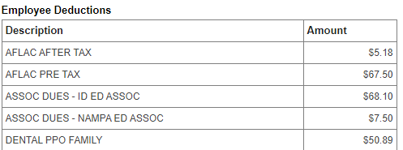
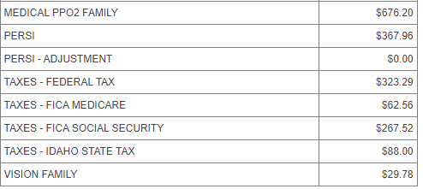

Slide 20
Social Security and Medicare (FICA)
The 2012 FICA Employee tax rates were as follows:
5.65% on the first $110,000 from wages and tips.
1.45% on income in excess for $110,000
Notes:
20

Slide 21
Example 3: Computing FICA Tax
If you are not self-employed and earn $150,000, what are your FICA taxes?
Notes:
21

Slide 22
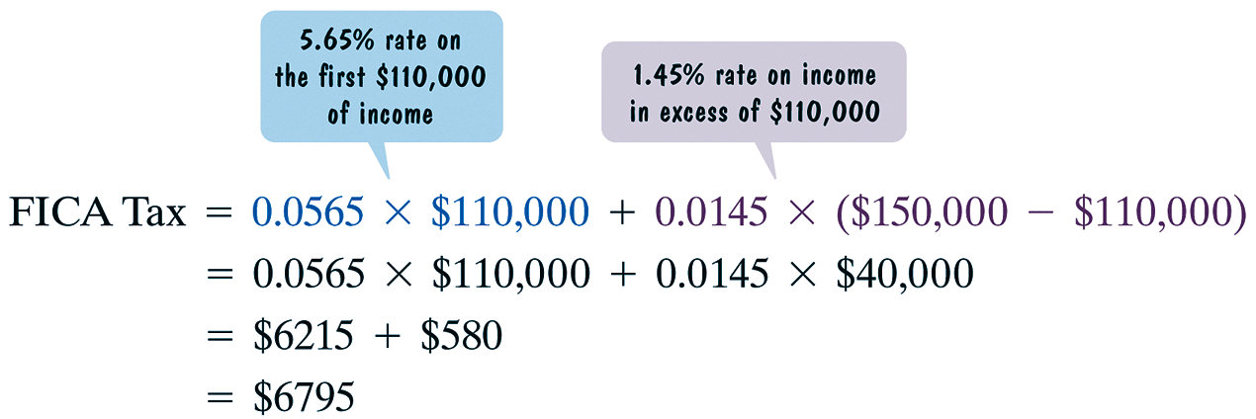
Example 3: Computing FICA Tax
If you are not self-employed and earn $150,000, what are your FICA taxes?
The tax rates are 5.65% on the first $110,000 of income and 1.45% on income in excess for $110,000.
The FICA taxes are $6795
Notes:
22

Slide 23
Example 4: Taxes for a Working Teen
You would like to have extra spending money and help save for college, so you decide to work part-time at the local gym. The job pays $10 per hour and you work 20 hours per week. Your employer withholds 10% of your gross pay for federal taxes, 5.65% for FICA taxes, and 3% for state taxes.
a. What is your weekly gross income?
b. How much is withheld per week for federal taxes?
c. How much is withheld per week for FICA taxes?
d. How much is withheld per week for state taxes?
e. What is your weekly net pay?
f. What percentage of your gross pay is withheld for taxes? Round
to the nearest tenth of a percent.
Notes:
23

Slide 24
Example 4: Taxes for a Working Teen continued
You would like to have extra spending money and help save for college, so you decide to work part-time at the local gym. The job pays $10 per hour and you work 20 hours per week. Your employer withholds 10% of your gross pay for federal taxes, 5.65% for FICA taxes, and 3% for state taxes.
Solution
a. Gross pay = 20 hours × $10/hr = $200
b. Federal Taxes: 10% of gross pay
0.10 × $200 = $20
c. FICA Taxes: 5.65% of gross pay
0.0565 × $200 = $11.30
Notes:
24

Slide 25
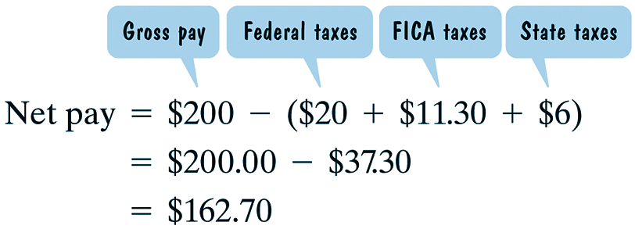
Example 4: Taxes for a Working Teen continued
You would like to have extra spending money and help save for college, so you decide to work part-time at the local gym. The job pays $10 per hour and you work 20 hours per week. Your employer withholds 10% of your gross pay for federal taxes, 5.65% for FICA taxes, and 3% for state taxes.
Solution
d. State Taxes: 3% of gross pay
0.03 × $200 = $6
e. Net Pay = Gross Pay – Deductions
Notes:
25

Slide 26
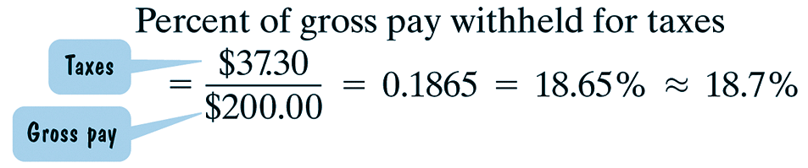
Example 5: continued
You would like to have extra spending money and help save for college, so you decide to work part-time at the local gym. The job pays $10 per hour and you work 20 hours per week. Your employer withholds 10% of your gross pay for federal taxes, 5.65% for FICA taxes, and 3% for state taxes.
Solution
f.
Notes:
26

