Slide 1

Chapter 7
Personal Finance: Taxes and Interest
Welcome Back!!!

Slide 2
7.1
Percent, Sales Tax, and Discounts

Slide 3
Targets
I can express a fraction as a percent.
I can express a decimal as a percent.
I can express a percent as a decimal.
I can solve applied problems involving sales tax and discounts.
I can determine percent increase or decrease.
I can investigate some of the ways percent can be abused.
Notes:
3

Slide 4
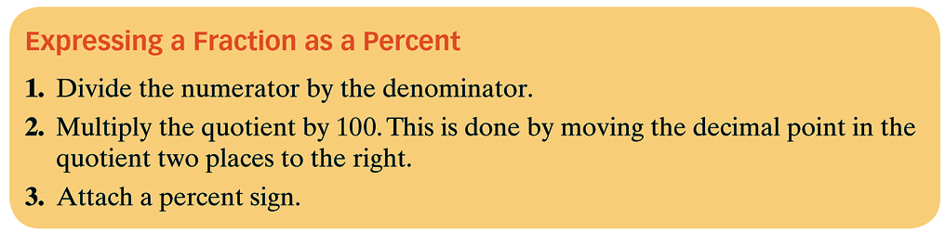
Basics of Percent
Percents are the result of expressing numbers as a part of 100.
The word percent means per hundred.
Notes:
4

Slide 5

Example 1: Expressing a Fraction as a Percent
Express as a percent.
Move the decimal two places to the right and attach %
$$5÷8=.625$$
62.5%
Notes:
5

Slide 6

Notes:
6

Slide 7
Example 2: Expressing a Decimal as a Percent
Express 0.47 as a percent.
47%
Notes:
7

Slide 8

Notes:
8

Slide 9
Example 3: Expressing Percents as Decimals
Express each percent as a decimal:
a. 19% b. 180%
a.
b.
.19
1.8
Notes:
9

Slide 10
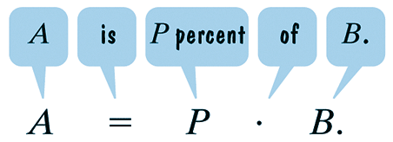
Percent, Sales Tax, & Discounts
Many applications involving percent are based on the following formula:
Note that “of” implies multiplication.
We use this formula to determine sales tax collected by states, counties, cities on sales items to customers.
Notes:
10

Slide 11


Example 4: Percent and Sales Tax
Suppose that the local sales tax rate is 7.5% and you purchase a bicycle for $894.
a. How much tax is paid?
b. What is the bicycle’s total cost?
$$.075∗894=\$67.05$$
$$894+67.05=\$961.05$$
Notes:
11

Slide 12
Percent and Sales Price
Businesses reduce prices, or discount, to attract customers and to reduce inventory.
The discount rate is a percent of the original price.
Notes:
12

Slide 13


Example 5: Percent and Sales Price
A computer with an original price of $1460 is on sale at 15% off.
a. What is the discount amount?
b. What is the computer’s sale price?
$$.15∗1460=\$219$$
$$1460−219=\$1241$$
Notes:
13

Slide 14
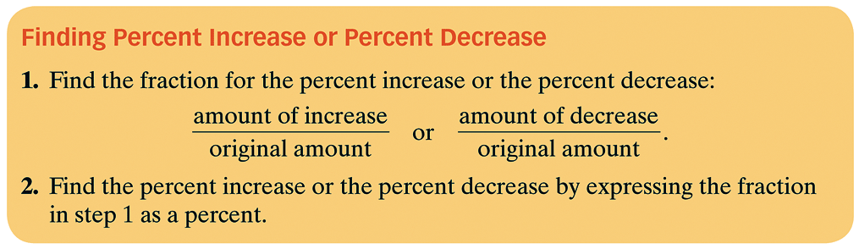
Percent and Change
If a quantity changes, its percent increase or its percent decrease can be found as follows:
Notes:
14

Slide 15
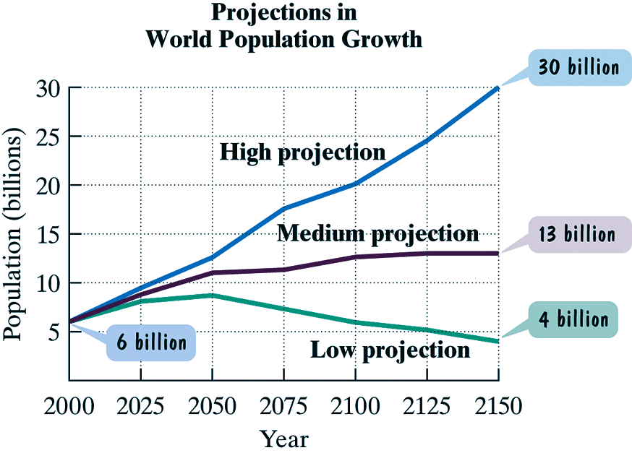
Example 6: Finding Percent Increase and Decrease
In 2000, world population was approximately 6 billion. The data are from United Nations Family Planning Program and are based on optimistic or pessimistic expectations for successful control of human population growth.
Find the percent increase in world population from 2000 to 2150 using the high projection data.
Find the percent decrease in world population from 2000 to 2150 using the low projection data.
Notes:
15

Slide 16
Example 6: Finding Percent Increase and Decrease continued
a. Use the data shown on the blue, high-projection, graph.
The projected percent increase in world population is 400%.
Notes:
16

Slide 17
Example 6: Finding Percent Increase and Decrease continued
Notes:
17

Slide 18
Example 6: Finding Percent Increase and Decrease continued
b. Use the data shown on the green, low-projection, graph.
The projected percent decrease in world population is 33⅓%.
Notes:
18

Slide 19

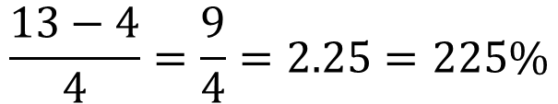
Example 8: Percents of Percents
John Tesh, while he was still co-anchoring Entertainment Tonight, reported that the PBS series The Civil War had an audience of 13% versus the usual 4% PBS audience, “an increase of more than 300%.” Did Tesh report the percent increase correctly?
$$Percent Increase=\frac{Amount of Increase}{Original Amount}$$
$$\frac{13−4}{4}=\frac{9}{4}=2.25=225\%$$
Notes:
19

Slide 20
Assignment
MyMathLab: Percent, Sales Tax, Discounts
Get this semester off to a good start!!!!

