Slide 1

Chapter 5
Algebra: Graphs, Functions, Linear Functions, and Linear Systems

Slide 2
5.2
Linear Functions and Their Graphs

Slide 3
Targets
I can use intercepts to graph a linear equation.
I can calculate slope.
I can use the slope and y-intercept to graph a line.
I can graph horizontal and vertical lines.
I can interpret slope as a rate of change.
I can use slope and y-intercept to model data.
Notes:
3

Slide 4

Graphing Using Intercepts
All equations of the form Ax + By = C are straight lines when graphed, as long as A and B are not both zero, and are called linear equations in two variables.

Slide 5
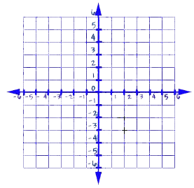






Example 1: Using Intercepts to Graph a Linear Equation
y-intercept, Plug 0 in for x
Graph: 3x + 2y = 6.
$$3\left(0\right)+2y=6$$
$$2y=6$$
(0, 3)
$$y=3$$
x-intercept, Plug 0 in for y
$$3x+2(0)=6$$
$$3x=6$$
(2, 0)
$$x=2$$

Slide 6
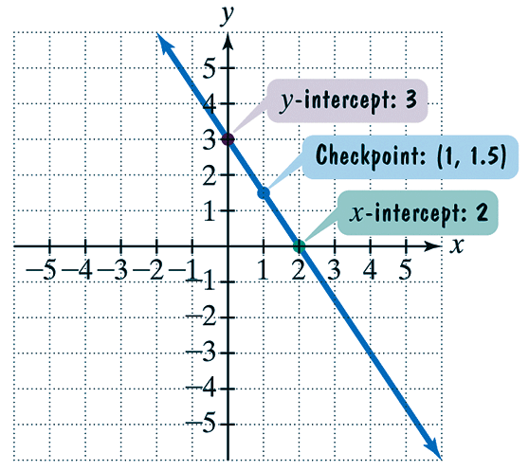
Example 1 continued
The x-intercept is 2, so the line passes through the point (2, 0). The y-intercept is 3, so the line passes through the point (0, 3).
Now, we verify our work by checking for x = 1. Plug x = 1 into the given linear equation.
We leave this to the student.
For x = 1, the y-coordinate should be 1.5.

Slide 7
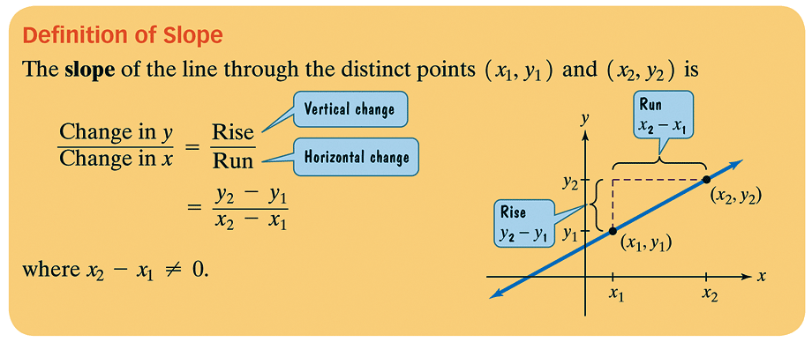
Slope

Slide 8
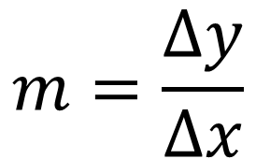
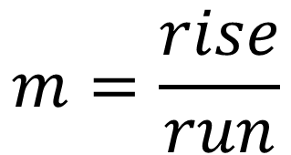


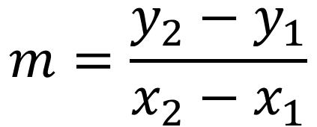
SLOPE
Given two points
$$\left(x_{1},y_{1} \right)$$
&
$$\left(x_{2},y_{2} \right)$$
$$m=\frac{rise}{run}$$
$$m=\frac{∆y}{∆x}$$
$$m=\frac{y_{2}−y_{1}}{x_{2}−x_{1}}$$

Slide 9
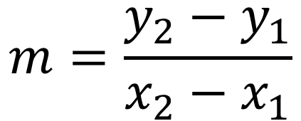
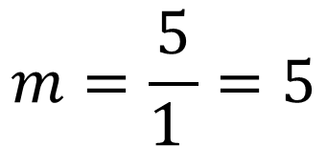
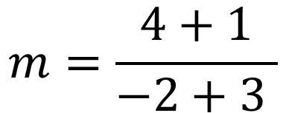
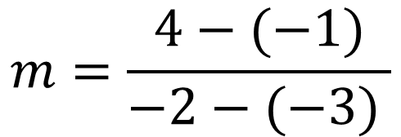
Example 2a: Using the Definition of Slope
Find the slope of the line passing through the pair of points: (−3, −1) and (−2, 4).
$$m=\frac{y_{2}−y_{1}}{x_{2}−x_{1}}$$
1
$$m=\frac{4−(−1)}{−2−(−3) }$$
5
$$m=\frac{4+1}{−2+3 }$$
$$m=\frac{5}{1 }=5$$

Slide 10
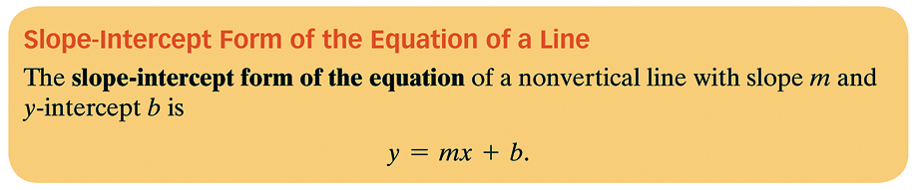
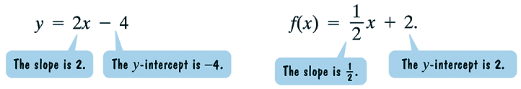
The Slope-Intercept Form of the Equation of a Line

Slide 11
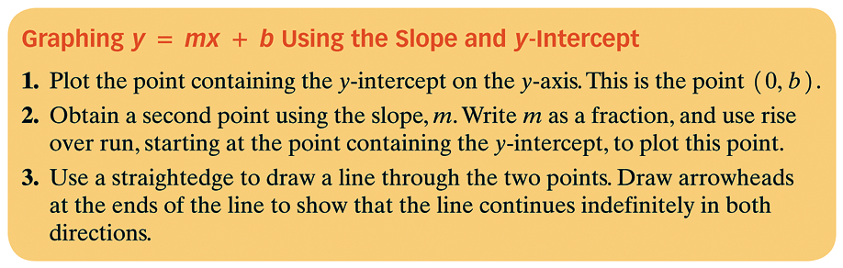
The Slope-Intercept Form of the Equation of a Line
Plot the y-intercept
From the y-intercept count the slope rise/run, and plot a second point
Draw the line through the two points

Slide 12
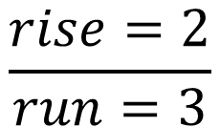
Example 3: Graphing by Using the Slope and y-intercept
Graph the linear function by using the slope
and y-intercept.
Plot the y-intercept
(0, 2)
From the y-intercept count the slope rise/run, and plot a second point
$$\frac{rise=2}{run=3}$$
Draw the line through the two points

Slide 13
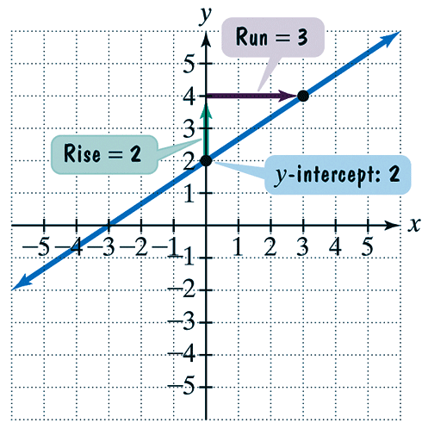
Example 3 continued
Step 1 Plot the point containing the y-intercept on the y-axis. The y-intercept is (0, 2).
Step 2 Obtain a second point using
the slope, m. The slope as a
Fraction is already given:
We plot the second point at (3, 4).
Step 3 Use a straightedge to draw a line through the two points.

Slide 14

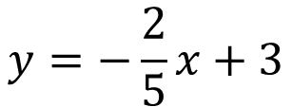
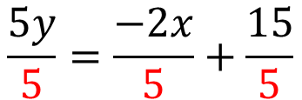

Example 4: Graphing by Using the Slope and y-intercept
Graph the linear function 2x + 5y = 15 by using the slope and y-intercept.
To solve for y
Move x-term to the other side of the equal sign
Divide everything by the number in front of y
$$2x+5y=15$$
$$5y=−2x+15$$
$$\frac{5y}{5}=\frac{−2x}{5}+\frac{15}{5}$$
$$y=−\frac{2}{5}x+3$$

Slide 15
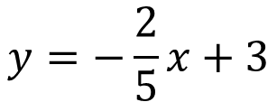
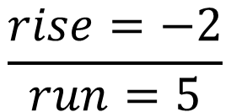
Example 4: Graphing by Using the Slope and y-intercept
$$y=−\frac{2}{5}x+3$$
Plot the y-intercept
(0, 3)
From the y-intercept count the slope rise/run, and plot a second point
$$\frac{rise=−2}{run=5}$$
Draw the line through the two points

Slide 16
Example 5: Graphing a Horizontal Line
Graph y = −4 in the rectangular coordinate system.
The y-coordinate is always -4

Slide 17
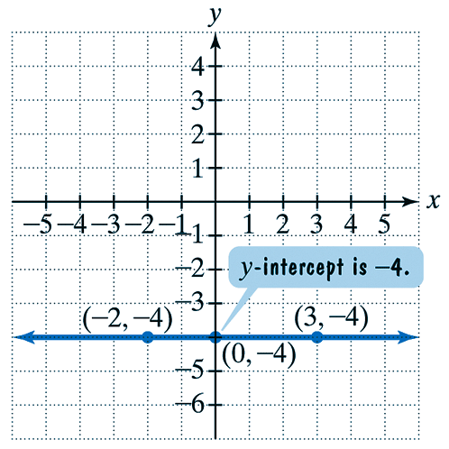
Example 5 continued
The graph of y = −4 or f(x) = −4.

Slide 18
Example 6: Graphing a Vertical Line
Graph x = 2 in the rectangular coordinate system.
The x-coordinate is always 2

Slide 19
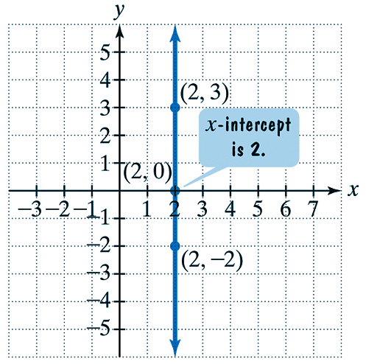
Example 6 continued
The graph of x = 2.
No vertical line represents a linear function.
All other lines are graphs of functions.

Slide 20
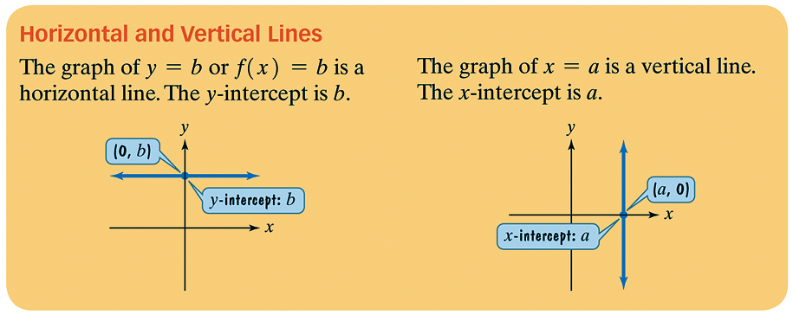
Horizontal and Vertical Lines
Horizontal Line y = c
Vertical Line x = c

Slide 21
Slope as Rate of Change
Slope is defined as the ratio of a change in y to a corresponding change in x.
Slope can be interpreted as a rate of change in an applied situation.

Slide 22
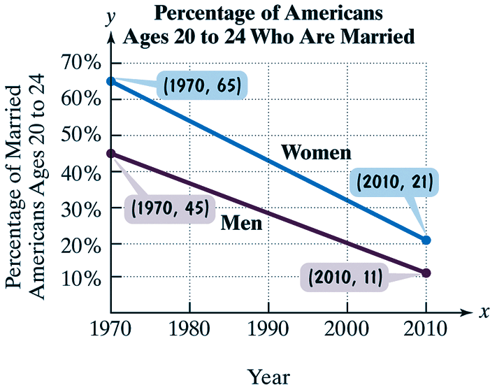
Example 7: Slope as a Rate of Change
The graph shows the percentage of American men and women ages 20 to 24 who were married from 1970 through 2010. Find the slope of the line segment representing women.
Describe what the slope represents.

Slide 23
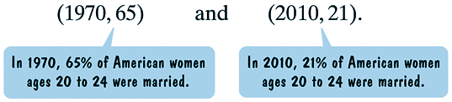
Example 7 continued
Solution Let x represent a year and y the percentage of American women ages 20 to 24 who were married in that year. The two points shown on the line segment for women have the following coordinates.

Slide 24
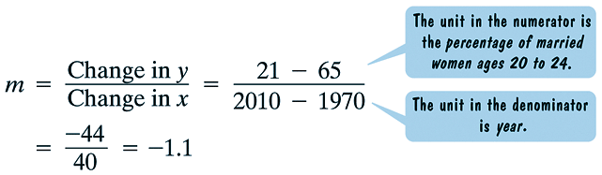
Example 7 continued
Now we compute the slope.
The slope indicates that for the period from 1970 through 2010, the percentage of married women ages 20 to 24 decreased by 1.1 per year. The rate of change is −1.1% per year.

Slide 25
Modeling Data with the Slope-Intercept Form of the Equation of a Line
Linear functions are useful for modeling data that fall on or near a line.
Assignment: MyMathLab

