Slide 1

Chapter 5
Algebra: Graphs, Functions, Linear Functions, and Linear Systems

Slide 2
5.1
Graphing and Functions

Slide 3
Targets
I can plot points in the rectangular coordinate system.
I can graph equations in the rectangular coordinate system.
I can use function notation.
I can graph functions.
I can use the vertical line test.
I can obtain information about a function from its graph.
Notes:
3

Slide 4
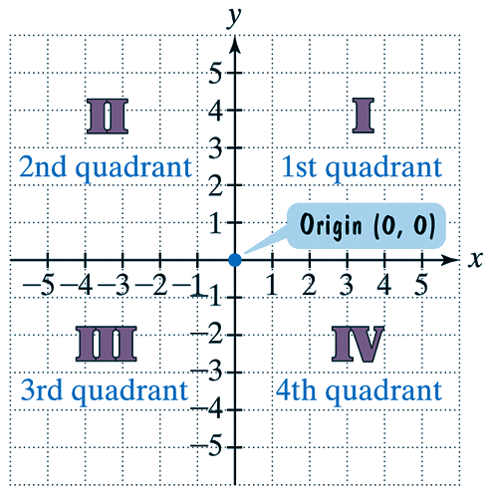
Points and Ordered Pairs
The horizontal number line is the x-axis.
The vertical number line is the y-axis.
The point of intersection of these axes is their zero point, called the origin.
Negative numbers are shown to the
left of and below the origin.
The axes divide the plane into four
quarters called “quadrants”.

Slide 5
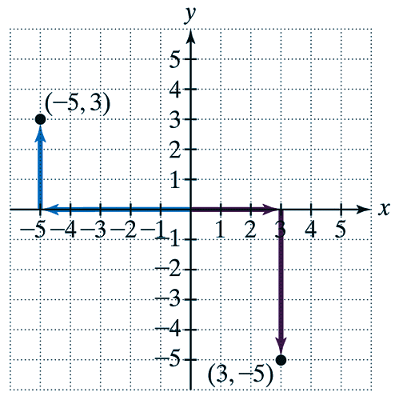
Points and Ordered Pairs
Each point in the rectangular coordinate system corresponds to an ordered pair of real numbers, (x, y).
Look at the ordered pairs
(−5, 3) and (3, −5).
The first number in each pair, called the x-coordinate, denotes the distance and direction from the origin along the x-axis.
The second number in each pair, called the y-coordinate, denotes the vertical distance and direction along the y-axis or parallel to it.
The figure shows how we plot, or locate the points corresponding to the ordered pairs.

Slide 6
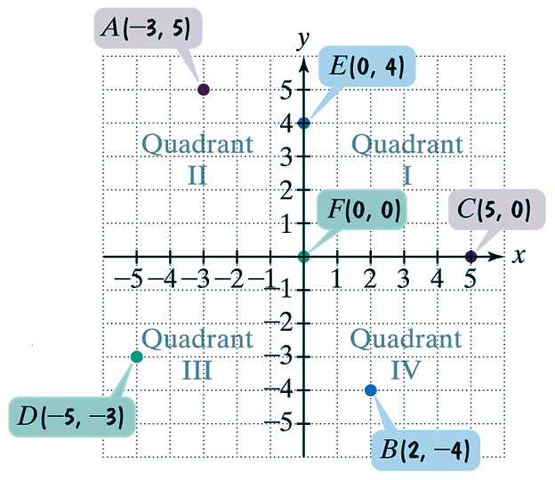
Example 1: Plotting Points in the Rectangular Coordinate System
Plot the points: A(−3, 5), B(2, −4), C(5,0), D(−5,−3), E(0, 4), and F(0, 0).
Solution We move from the origin and plot the point in the following way:
A(−3,5) | 3 units left, 5 units up
B(2, −4) | 2 units right, 4 units down
C(5,0) | 5 units right, 0 units up or down
D(−5, −3) | 5 units left, 3 units down
E(0,4) | 0 units left or right, 4 units up
F(0,0) | 0 units left or right, 0 units up or down

Slide 7
Graphs of Equations
A relationship between two quantities can be expressed as an equation in two variables, such as
y = 4 – x².
A solution of an equation in two variables, x and y, is an ordered pair of real numbers with the following property:
  When the x-coordinate is substituted for x and the y coordinate is substituted for y in the equation, we obtain a true statement.
The graph of an equation in two variables is the set of all points whose coordinates satisfy the equation.

Slide 8





















Example 2: Graphing an Equation Using the Point-Plotting Method
Graph y = 4 – x². Select integers for x, starting with −3 and ending with 3.
Solution For each value of x, we find the corresponding value for y.
$$y=4−{(−3)}^{2}$$
$$y=4−{(−2)}^{2}$$
$$y=4−{(−1)}^{2}$$
$$y=4−9$$
$$y=4−4$$
$$y=4−1$$
$$y=−5$$
$$y=0$$
$$y=3$$
$$y=4−{(0)}^{2}$$
$$y=4−{(1)}^{2}$$
$$y=4−{(2)}^{2}$$
$$y=4−{(−3)}^{2}$$
$$y=4−0$$
$$y=4−1$$
$$y=4−4$$
$$y=4−9$$
$$y=4$$
$$y=3$$
$$y=0$$
$$y=−5$$

Slide 9
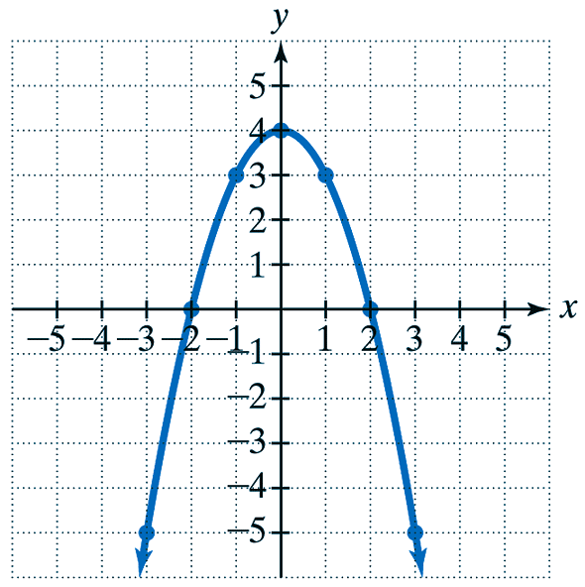
Example 2 continued
Now plot the seven points and join them with a smooth curve.
x | y
-3 | -5
-2 | 0
-1 | 3
0 | 4
1 | 3
2 | 0
3 | -5

Slide 10
Functions
If an equation in two variables (x and y) yields precisely one value of y for each value of x, we say that y is a function of x.
The notation y = f(x) indicates that the variable y is a function of x. The notation f(x) is read “f of x.”

Slide 11
Example 6: Graphing Functions
Graph the functions f(x) = 2x and g(x) = 2x + 4 in the same rectangular coordinate system. Select integers for x, −2 ≤ x ≤ 2.
Solution For each function we use tables to display the coordinates:
f(x) = 2x
g(x) = 2x + 4
x | f(x)
-2 | -4
-1 | -2
0 | 0
1 | 2
2 | 4
x | g(x)
-2 | 0
-1 | 2
0 | 4
1 | 6
2 | 8

Slide 12
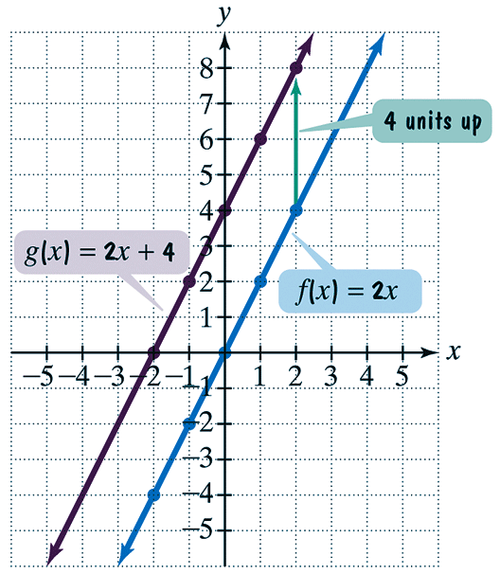
Example 6 continued
Next, plot the five points for each function and connect them.
Do you see a relationship between the two graphs?

Slide 13
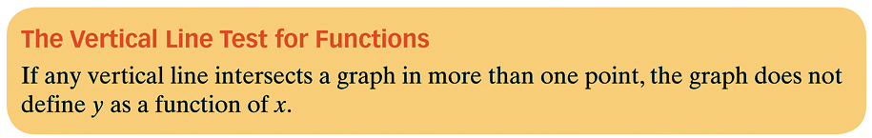
Vertical Line Test

Slide 14
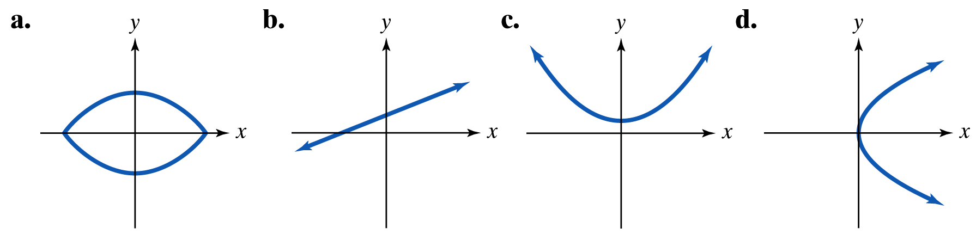
Example 7: Using the Vertical Line Test
Use the vertical line test to identify graphs in which y is a function of x.

Slide 15
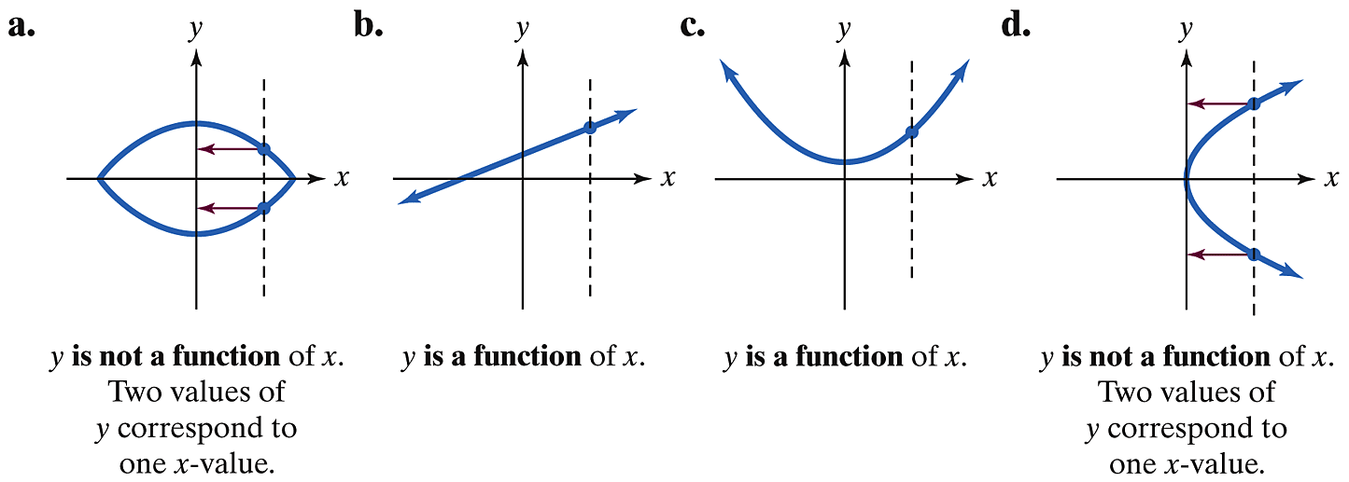
Example 7 continued
Solution y is a function of x for the graphs in (b) and (c).

Slide 16
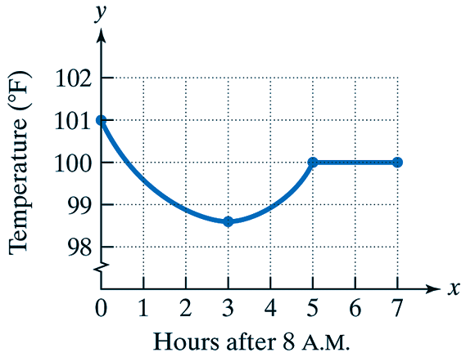
Example 8: Analyzing the Graph of a Function
The given graph illustrates the body temperature from 8 a.m. through 3 p.m. Let x be the number of hours after 8 a.m. and y be the body temperature at time x.
a. What is the temperature at 8 a.m.?
b. During which period of time is
your temperature decreasing?
c. Estimate your minimum
temperature during the time
period shown. How many hours after 8 a.m. does this occur? At what time does this occur?

Slide 17
Example 8 continued
d. During which period of time is your temperature increasing?
e. Part of the graph is shown as a horizontal line segment. What does this mean about your temperature and when does this occur?
f. Explain why the graph defines y as a function of x.

Slide 18
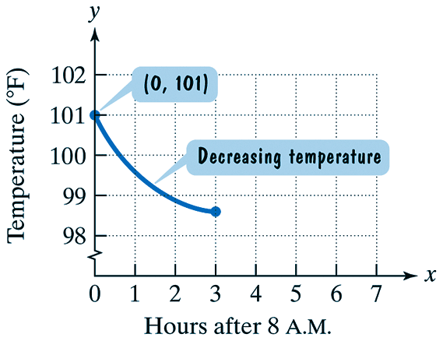
Example 8 continued
Solution
a. The temperature at 8 a.m. is when x is 0, since no time has passed when it is 8 a.m. The temperature at 8 a.m. is 101°F.
b. The temperature is decreasing
when the graph falls from left to
right. This occurs between x = 0
and x = 3. Thus, the temperature
is decreasing between the times
8 a.m. and 11 a.m.

Slide 19
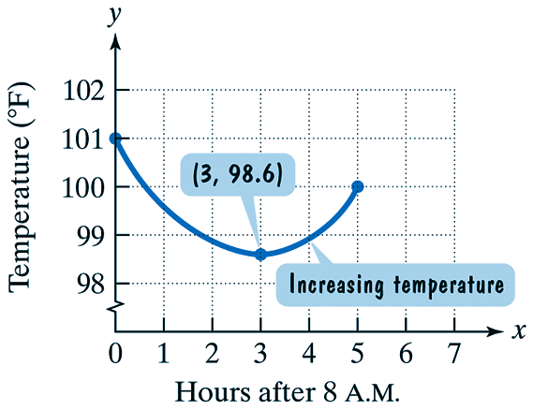
Example 8 continued
c. The minimum temperature can be found by locating the lowest point on the graph. This point lies above 3 on the horizontal axis. The y-coordinate falls midway between 98 and 99, at ap-
proximately 98.6. Thus, the minimum temperature is 98.6°F at 11 a.m.
d. The temperature is increasing
when the graph rises from
left to right. This occurs
between x = 3 and x = 5.
Thus, the temperature is
increasing from 11 a.m. to 1 p.m.

Slide 20
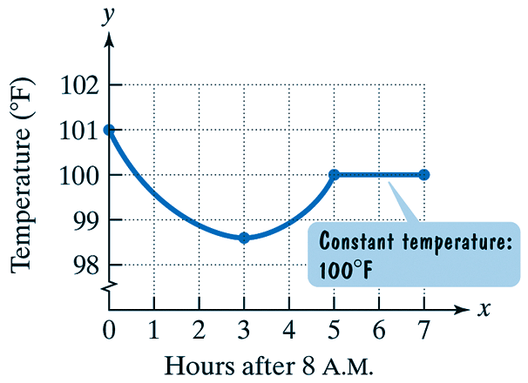
Example 8 continued
e. The horizontal line segment shown
indicates that the temperature is
neither increasing nor decreasing.
The temperature remains the same
at 100°F, between x = 5 and x = 7.
Thus, the temperature is at a constant
100°F between 1 p.m. and 3 p.m.
f. By the vertical line test we can see that no vertical line will intersect the graph more than once. So, the body temperature is a function of time. Each hour represents one body temperature.

Slide 21
Assignment
MyMathLab: Graphing & Functions

